Slide 1

DriverPass System Analysis
Jessica Bains
Notes:
[No speaker notes required for this slide.]

Slide 2

System Requirements
Non-functional Requirement
The system should be easily updated when the DMV requirements change.
The system should stay up-to-date with security features to prevent breaches.
Functional Requirement
The system shall validate user credentials when logging in.
The system shall let the owner disable packages and allow users to choose packages.
Notes:
For non- functional requirements, it is important that the system can be easily updated when the DMV guidelines have changed. This should be added promptly so the students are learning the most relevant and accurate information needed to succeed their driving tests. The system should also be up-to-date with security features to prevent unauthorized access to sensitive information. Functional requirements for DriverPass system are that the system shall validate users unique username/password when logging in and once the users credentials are validated they can have access to their accounts. If the user fails to enter the username/password more than three times, the account will be locked. Another functional requirement is that the system shall let the owner disable packages when its gets full and allow users to choose packages from their accounts.

Slide 3
Use Case Diagram
Notes:
The users involved in the system are customers, owner, secretary, and IT officer. The system should be able to register customers, verify login, manage packages, access DMV updates, generate Activity Report, schedule Appointments, manage appointments that includes schedule appointments, modify appointment and cancel appointment, etc. Users needs to able reset their own passwords. The IT officer can also help reset passwords as well. The IT officer should also be able to block access or delete account when needed. The owner needs to be disable packages. The secretary needs to be able manage, conform, and schedule appointments. DriverPass also needs to be able to verify and process customer payments and have an option where students can view their driver notes.

Slide 4
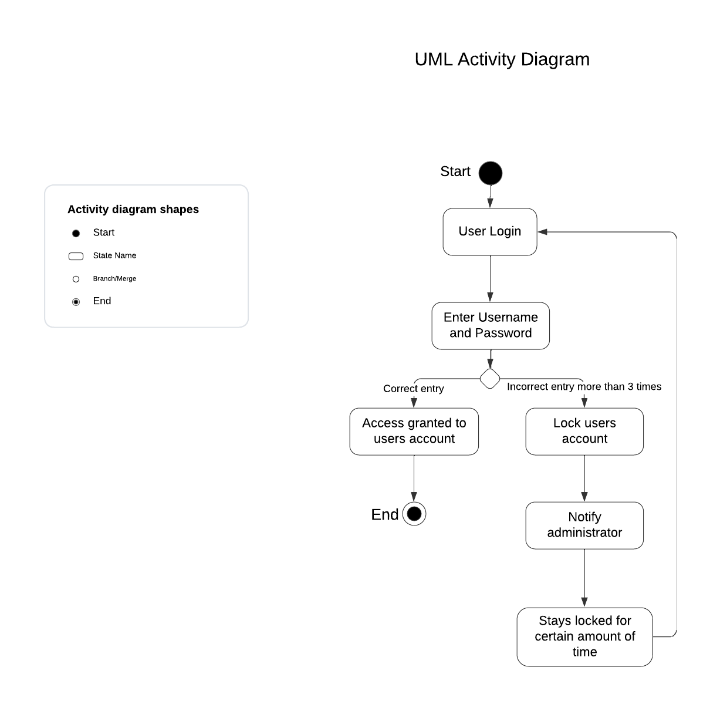
Activity Diagram
Notes:
In DriverPass, users need to log in using their username and password. In this diagram, we break down the steps for user login. The users will first enter their username and password. The system will then verify if the information is correct. If the information is correct, the users will be granted access to their accounts. If the information is entered incorrectly more than three times, the system will lock the account. When that happens, the administrator will be notified. The account stays unlocked for a certain amount of time before users can try logging in to the accounts again.

Slide 5
Security
All users are required to have a unique and case-sensitive username and password to log in.
Cloud ensure a secure connection or the data exchange between the client and the server.
The account will be locked after three failed attempts and administer will be notified.
Users can reset their own passwords with their email.
Notes:
System is an important part of the systems design and to keep the trust of customers. DriverPass is hosted on a cloud. Cloud ensures a secure connection and data exchange between the client and the server. Users will have unique and case-sensitive passwords to log in their accounts. If there is a “brute force” hacking attempt the account will be locked. There are a certain number of attempts to log in the account with the correct username and password, if they fail to do so, the users account will be locked and the administrator will be notified. If the user forgets their password, they should be able to click a link where they can reset their password by receiving a temporary password through their email associated with the account.

Slide 6
System Limitations
The system needs a good internet connection to run smoothly.
Users’ needs a computer or a mobile device to use the application.
DMV rules and exams question will need to be updated upon DMV notification.
Customers might not have the money to pay for lessons.
There are limited cars so the customers might have to schedule ahead of time, in case, the days they are available are booked.
Notes:
Some of the limitation in the system design are that users needs to have good internet connection in order for the system to run smoothly, users’ needs a computer or a mobile device to use the application, DMV rules and exams question will need to be updated upon DMV notification, customers might not have the money to pay for lessons, and there are limited cars so the customers might have to schedule ahead of time, in case, the days they are available are booked.

